Slide 1
Ridership Analysis Of
CYCLISTIC BIKE SHARE
To analyse customer behaviour
aimed at converting casual riders
into annual members
Presented By: Ayushya Ujjwal
July 2022

Slide 2
CONTENTS
Most Popular Bike Types
2. Analysis by Membership Types
3. Analysis of Rides by Month
4. Daily Ridership Analysis by Membership Type
5. Top 5 Start and End Stations
6. Key Findings
7. Recommendations

Slide 3
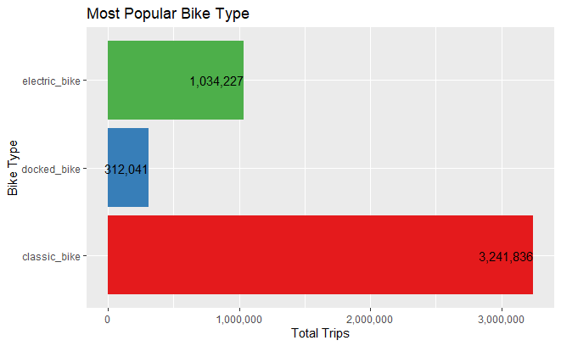
Most Popular Bike Types
Classic Bike is the most popular amongst riders, followed by Electric bikes.
Docked bike is their least favourite.

Slide 4
Analysis by Membership Types
Let’s take a look at ridership trends based on the membership type. Here, we will go through:
Rider Distribution by Membership
Average ride duration by membership type

Slide 5
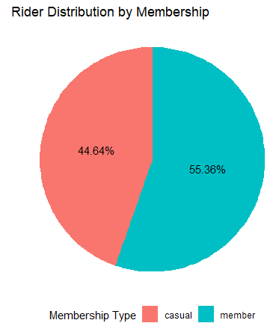
45% customers are Casual riders
Company’s success lies in converting the Casual riders to Members

Slide 6
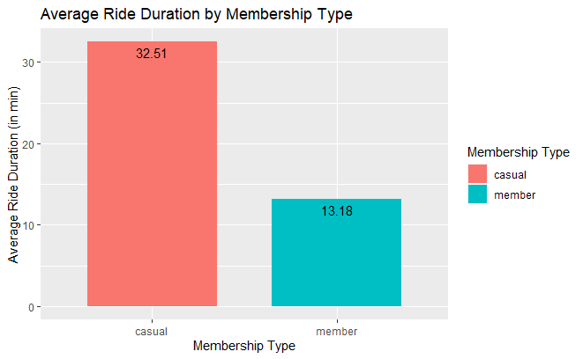
Casual riders have longer average ride duration than the Members.

Slide 7
Analysis of Rides by Month and Membership Types
Let’s take a look at the monthly ride trends as per the 2 membership types. We will go through:
Rides per month by Membership Type
Average Monthly Ride Duration by membership Type

Slide 8
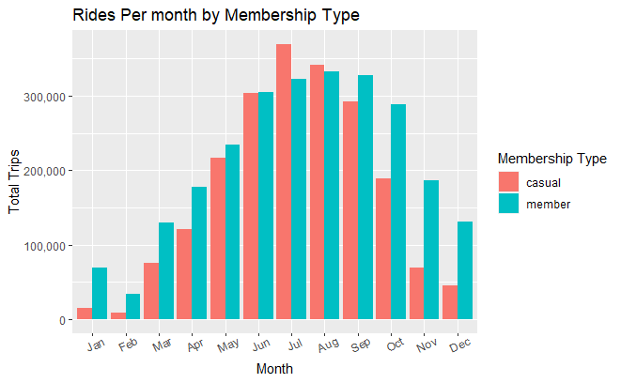
The months of June-September are the busiest throughout the year for both, the Members, and the Casual riders.

Slide 9
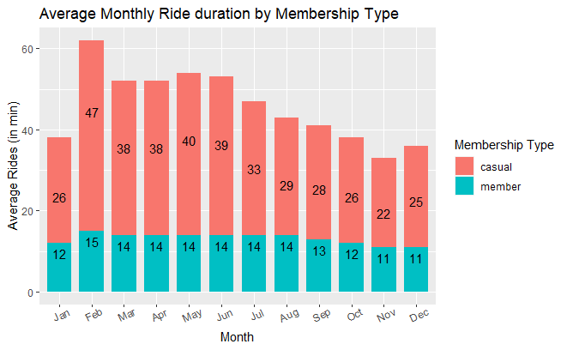
Casual riders have an average ride time more than that of the Members, throughout the year.

Slide 10
Daily Ridership Analysis by Membership Types
Let’s take a look at the daily patterns of both the rider groups. Here, we’ll go through the:
Total daily Rides by Membership Type
Daily Average Ride Duration by Membership Type

Slide 11
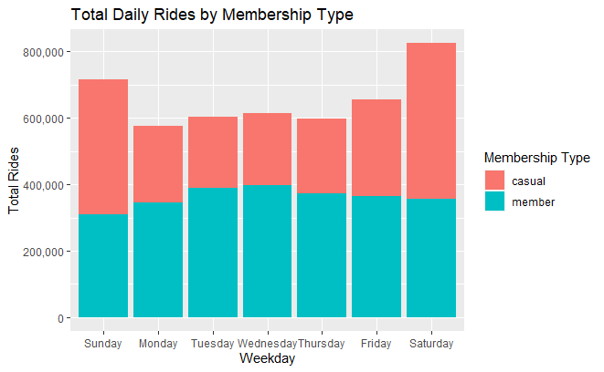
Total rides are the highest during the weekend.
But, ride time of members during weekdays is more as compared to the same during weekends.

Slide 12
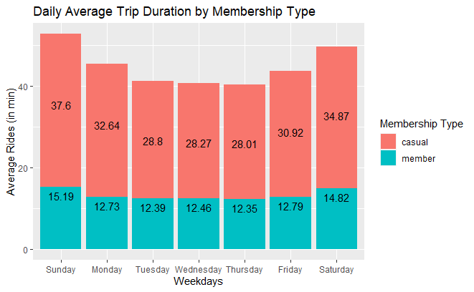
Even the average ride duration is highest for both user types during the weekends.

Slide 13
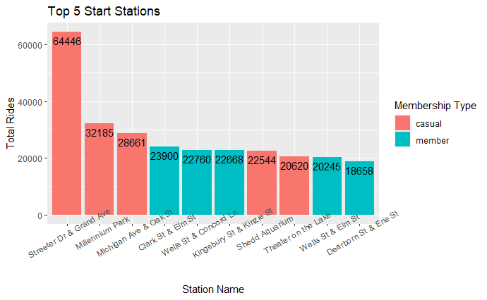
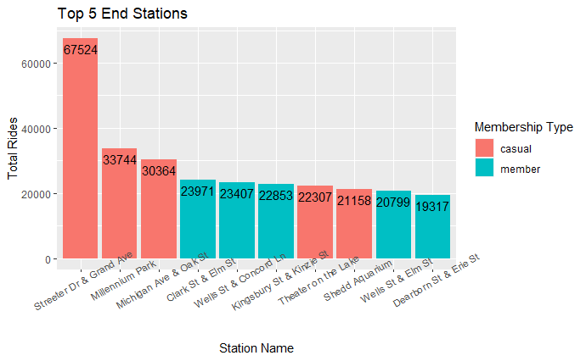
TOP 5 START AND END STATIONS
Top 5 Start and End
Stations are same for
both type of users

Slide 14
45% of the user base comprises of Casual riders.
Casual riders (32 mins) have a higher average ride time than the Members (13 mins).
KEY FINDINGS
June to September are the busiest months, throughout the year.
Number of weekend rides are more than weekday rides.
Casual Riders are more likely to use the bikes for recreational purposes, whereas Members are more likely to use bikes to commute between workplaces.

Slide 15
RECOMMENDATIONS
Seasonal/Quarterly Pass:
A seasonal pass during the months of Jun-Sep should be introduced at a price proportional to annual membership.
2. Advertising at the Right Locations:
Riders at the top 5 stations should be offered additional perks along with the Annual Membership.
3. Referral Scheme:
A friend referral program offering discounted Annual membership rate and perks to the referrer.

Slide 16
THANK YOU!

